Slide 1
Dependency Injection
Crystal Tenn
Crystal.Tenn@microsoft.com

Slide 2
What is Dependency Injection (DI)?
Notes:
Benefits of containers include: Density and agility, enabling agile application development and deployment
Don’t mistake Hyper-V container with a VM – containers are much more agile (deploy with a flip of the bits, etc.)

Slide 3

What is Dependency Injection?
A asdasdasdasdafor running large-scale parallel and high-performance computing (HPC) applications efficiently in the cloud.
Azure Batch schedules compute-intensive work to run on a managed collection of virtual machines, and can automatically scale compute resources to meet the needs of your jobs.

Slide 4
When and why to use DI?
Notes:
Benefits of containers include: Density and agility, enabling agile application development and deployment
Don’t mistake Hyper-V container with a VM – containers are much more agile (deploy with a flip of the bits, etc.)

Slide 5
When and why to use DI?
A asdasdasdasdafor running large-scale parallel and high-performance computing (HPC) applications efficiently in the cloud.
Azure Batch schedules compute-intensive work to run on a managed collection of virtual machines, and can automatically scale compute resources to meet the needs of your jobs.

Slide 6
What are the benefits of DI?
Notes:
Benefits of containers include: Density and agility, enabling agile application development and deployment
Don’t mistake Hyper-V container with a VM – containers are much more agile (deploy with a flip of the bits, etc.)

Slide 7
What are the benefits of DI?
A asdasdasdasdafor running large-scale parallel and high-performance computing (HPC) applications efficiently in the cloud.
Azure Batch schedules compute-intensive work to run on a managed collection of virtual machines, and can automatically scale compute resources to meet the needs of your jobs.

Slide 8
Let’s look at a simple code example of DI

Slide 9
Simple Code Example of DI
A asdasdasdasdafor running large-scale parallel and high-performance computing (HPC) applications efficiently in the cloud.
Azure Batch schedules compute-intensive work to run on a managed collection of virtual machines, and can automatically scale compute resources to meet the needs of your jobs.

Slide 10
Compare the main DI frameworks

Slide 11
Compare the main DI frameworks
Mef
Mef2
Unity
Ninject
Castle Windsor
Autofac
StructureMap
Performance comparisons:
https://github.com/danielpalme/IocPerformance
http://www.palmmedia.de/Blog/2011/8/30/ioc-container-benchmark-performance-comparison

Slide 12
Compare the main DI frameworks
Microsoft released three versions of MEF using two only unique names: MEF and MEF2
System.ComponentModel.Composition.* MEF in .NET 4 (typically called just MEF), no support for CompositionScopes, ExportFactories, etc
System.ComponentModel.Composition.* MEF2 in .NET 4.5 (sometimes called MEF2 or MEF), support for composition scopes, ExportFactories
System.Composition.* from independent package Microsoft.Composition lightweight version of MEF typically called MEF2
The benchmark site refers to lightweight MEF2 System.Compostion.* from Microsoft.Composition package.

Slide 13
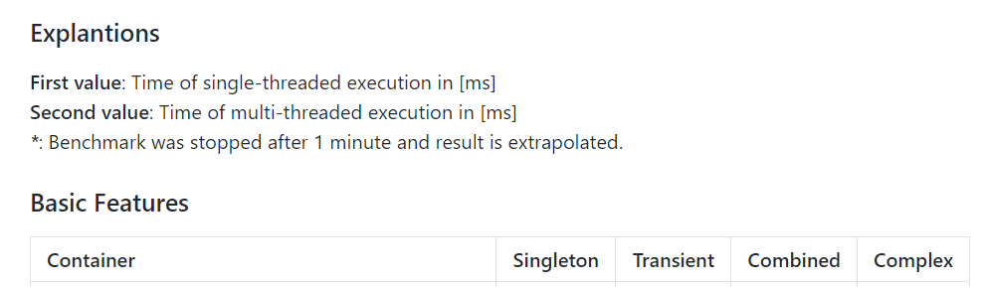
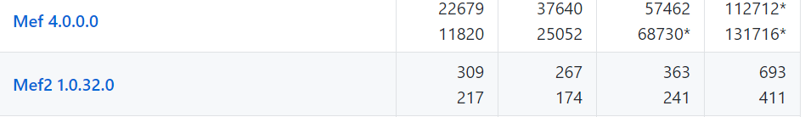
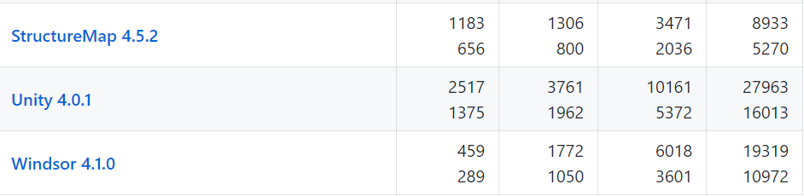
Singleton: Objects with is singleton lifetime are resolved
Transient: Objects with is transient lifetime are resolved
Combined: Objects with two dependencies (singleton and transient lifetime) are resolved
Complex: Objects with several nested dependencies are resolved
Mef2, Autofac, StructureMap, and Castle Windsor and are the fastest DI frameworks, though it depends on what type of objects.
Mef, Unity, and Ninject are the slowest.
Notes:
https://github.com/danielpalme/IocPerformance
http://www.palmmedia.de/Blog/2011/8/30/ioc-container-benchmark-performance-comparison

Slide 14
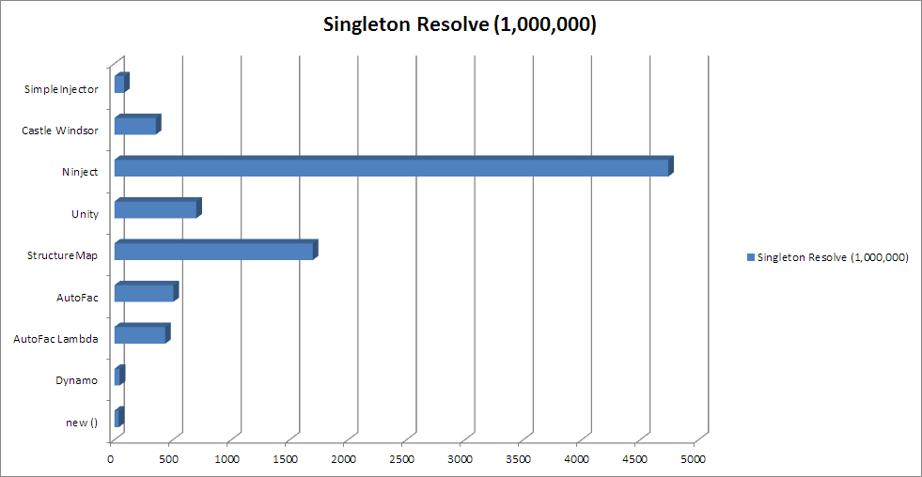
https://cardinalcore.co.uk/2015/01/28/ioc-battle-in-2015-results-using-ninject-think-again/
Notes:
https://cardinalcore.co.uk/2015/01/28/ioc-battle-in-2015-results-using-ninject-think-again/

Slide 15
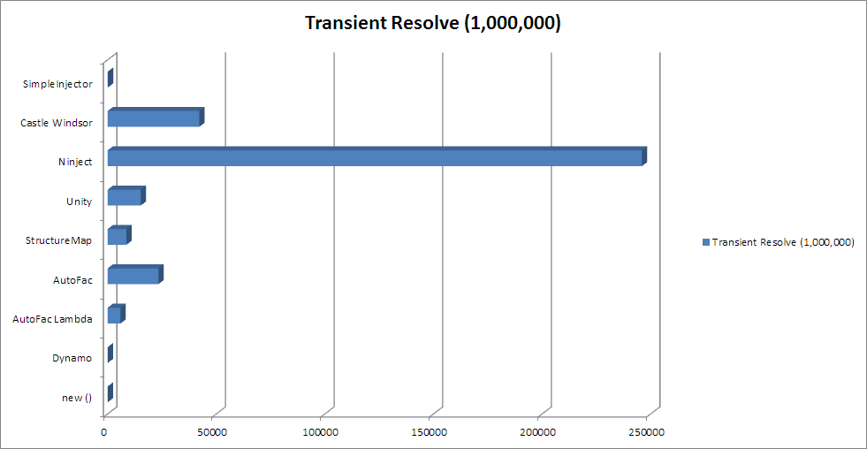
https://cardinalcore.co.uk/2015/01/28/ioc-battle-in-2015-results-using-ninject-think-again/
Notes:
https://cardinalcore.co.uk/2015/01/28/ioc-battle-in-2015-results-using-ninject-think-again/

Slide 16
Demo
Implementing Dependency Injection
Notes:
End 37 mins

Slide 17
Mef
Crystal Tenn
Crystal.Tenn@microsoft.com

Slide 18
What is Mef?

Slide 19
Mef DI Framework
A asdasdasdasdafor running large-scale parallel and high-performance computing (HPC) applications efficiently in the cloud.
Azure Batch schedules compute-intensive work to run on a managed collection of virtual machines, and can automatically scale compute resources to meet the needs of your jobs.

Slide 20
What is Mef?

Slide 21
Mef DI Framework
A asdasdasdasdafor running large-scale parallel and high-performance computing (HPC) applications efficiently in the cloud.
Azure Batch schedules compute-intensive work to run on a managed collection of virtual machines, and can automatically scale compute resources to meet the needs of your jobs.

Slide 22
Advantages and features of Mef?

Slide 23
Advantages and features of Mef?
A asdasdasdasdafor running large-scale parallel and high-performance computing (HPC) applications efficiently in the cloud.
Azure Batch schedules compute-intensive work to run on a managed collection of virtual machines, and can automatically scale compute resources to meet the needs of your jobs.

Slide 24
Disadvantages?

Slide 25
Disadvantages?
A asdasdasdasdafor running large-scale parallel and high-performance computing (HPC) applications efficiently in the cloud.
Azure Batch schedules compute-intensive work to run on a managed collection of virtual machines, and can automatically scale compute resources to meet the needs of your jobs.

Slide 26
How do I add it to my project?

Slide 27
How do I add it to my project?
A asdasdasdasdafor running large-scale parallel and high-performance computing (HPC) applications efficiently in the cloud.
Azure Batch schedules compute-intensive work to run on a managed collection of virtual machines, and can automatically scale compute resources to meet the needs of your jobs.

Slide 28
How do I implement it?

Slide 29
How do I implement it?
A asdasdasdasdafor running large-scale parallel and high-performance computing (HPC) applications efficiently in the cloud.
Azure Batch schedules compute-intensive work to run on a managed collection of virtual machines, and can automatically scale compute resources to meet the needs of your jobs.

Slide 30
Lab
Implementing Mef DI Framework
Notes:
End 37 mins

Slide 31
Unity
Crystal Tenn
Crystal.Tenn@microsoft.com

Slide 32
What is Unity?

Slide 33
Unity DI Framework
A asdasdasdasdafor running large-scale parallel and high-performance computing (HPC) applications efficiently in the cloud.
Azure Batch schedules compute-intensive work to run on a managed collection of virtual machines, and can automatically scale compute resources to meet the needs of your jobs.

Slide 34
Advantages and features of Unity?

Slide 35
Advantages and features of Unity?
A asdasdasdasdafor running large-scale parallel and high-performance computing (HPC) applications efficiently in the cloud.
Azure Batch schedules compute-intensive work to run on a managed collection of virtual machines, and can automatically scale compute resources to meet the needs of your jobs.

Slide 36
Disadvantages?

Slide 37
Disadvantages?
A asdasdasdasdafor running large-scale parallel and high-performance computing (HPC) applications efficiently in the cloud.
Azure Batch schedules compute-intensive work to run on a managed collection of virtual machines, and can automatically scale compute resources to meet the needs of your jobs.

Slide 38
How do I add it to my project?

Slide 39
How do I add it to my project?
A asdasdasdasdafor running large-scale parallel and high-performance computing (HPC) applications efficiently in the cloud.
Azure Batch schedules compute-intensive work to run on a managed collection of virtual machines, and can automatically scale compute resources to meet the needs of your jobs.

Slide 40
How do I implement it?

Slide 41
How do I implement it?
A asdasdasdasdafor running large-scale parallel and high-performance computing (HPC) applications efficiently in the cloud.
Azure Batch schedules compute-intensive work to run on a managed collection of virtual machines, and can automatically scale compute resources to meet the needs of your jobs.

Slide 42
Lab
Implementing Unity DI Framework
Notes:
End 37 mins

Slide 43
Comparing Mef vs Unity
Crystal Tenn
Crystal.Tenn@microsoft.com

Slide 44
Deep level comparison of Mef vs. Unity

Slide 45
Deep level comparison of Mef vs. Unity
A asdasdasdasdafor running large-scale parallel and high-performance computing (HPC) applications efficiently in the cloud.
Azure Batch schedules compute-intensive work to run on a managed collection of virtual machines, and can automatically scale compute resources to meet the needs of your jobs.

Slide 46
When to use Mef…

Slide 47
When to use Mef
If you app is this
Or this
Or this
Or this

Slide 48
When to use Unity…

Slide 49
When to use Unity
If you app is this
Or this
Or this
Or this

Slide 50
Tight-Coupling and
Dependency Injection
Rob Vettor, Application Developer Consultant Microsoft Premier Support Services

Slide 51





Why we are here?
Examine
Demos
Tight Coupling
Inversion of Control
Service Locator
Dependency Injection
Dependency Resolver
Which one?
Understand
Question
Increase productivity
Key Takeaways
Understand Dependency Injection and its benefits

Slide 52
What’s Wrong with this Component?
Fact: Takes 3 dependencies
public class StoreManagerController : Controller
{
private AlbumService _albumService;
private ArtistService _artistService;
private GenreService _genreService;
public StoreManagerController()
{
_albumService = new AlbumService();
_genreService = new GenreService();
_artistService = new ArtistService();
}
Concern: Explicitly creates dependencies
Concern: Communicates directly with concrete classes
Fact: Relationship said to be “Tightly Coupled”

Slide 53

Tight Coupling
Component contains hard-coded references to dependent classes…
Resistant to change
Changing dependent class can affect component
Requires recompiling and testing component
Hard to unit test
Difficult to quickly swap-out mock classes for testing
Considered liability in your design…
Accuring technical debt

Slide 54
Reducing Responsibility
Shift responsibility for instantiating dependent classes from component to consuming code
Receives dependencies via constructor
(constructor injection)
public class StoreManagerController : Controller
{
private readonly AlbumService _albumService;
private readonly ArtistService _artistService;
private readonly GenreService _genreService;
public StoreManagerController(AlbumService albumService,
GenreService genreService, ArtistService albumService)
{
_albumService = albumService;
_genreService = genreService;
_artistService = artistService;
}

Slide 55
Constructor Injection
Inverts control
Relieves component from responsibility of creating dependency classes
Instantiation moved outside
Two problems still persist:
Component still tightly-coupled to concrete classes
Calling class now becomes more complex (must instantiate and inject dependent classes)

Slide 56
Reducing Coupling
Add abstraction layer between component and dependencies by implementing interfaces
Interface references
public class StoreManagerController : Controller
{
private readonly IAlbumService _albumService;
private readlonly IArtistService _artistService;
private readonly IGenreService _genreService;
public StoreManagerController(IAlbumService albumService,
IGenreService genreService, IArtistService albumService)
{
_albumService = albumService;
_genreService = genreService;
_artistService = artistService;
}
Communicates with concrete class via interface

Slide 57
Refactoring to Interfaces
Components depend on interfaces…
Communicates directly with interface
Not aware of underlying concrete class
Plug in any concrete class that implements interface
Plug-in (inject) any class that implements interface
Inject implementation without modifying component
Flexibility/Interchangeability
Inject fake/mock implementations for unit testing

Slide 58
Tight-Coupling to… Loose-Coupling
We Have Improved…

Slide 59
Loose Coupling
Implement Interface-based design to communicate across layers -- enforces loose coupling
Controller, Services, Repositories all loosely coupled with interface references
A layer should not expose internal details on which another layer could depend
One Layer can Mock or Fake another layer to isolate functionality in order to create unit tests…
IService
IRepository
Controller
Service
Repository
Controller has dependency on Service-interface
Service has dependency on Repository-interface
Repository has dependency on DbContext-interface

Slide 60
Demo
Adding interfaces for communicating across layers

Slide 61

Design Still Has Problems…
Calling code too complex…
It is now responsible for selecting, instantiating and injecting dependencies into component

Slide 62
Inversion of Control (IoC)
Widely-accepted design principle
Promotes loose coupling between objects by inverting the control flow of an application
Dependent object receives its dependencies from a container, instead of explicitly instantiating them
Improves Unit testing, maintainability, extensibility and interchangeability

Slide 63
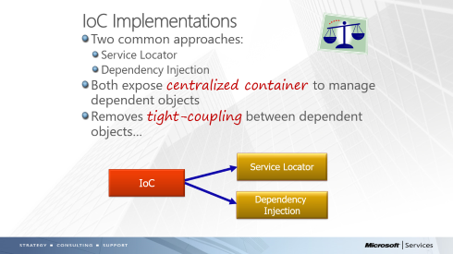

IoC Implementations
Two common approaches:
Service Locator
Dependency Injection
Both expose centralized container to manage dependent objects
Removes tight-coupling between dependent objects…
Service Locator
IoC
Dependency
Injection

Slide 64
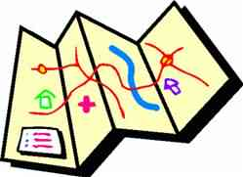
Service Locator
Adopts pull model – you ask container to create an object on your behalf
On Demand
Query locator via key or interface type
Similar to Factory Pattern, but…
Locator can manage lifetime of dependent object (maintains instance)
Capable of returning reference to any object, while Factories typically return a specific family of types
Component takes dependency on Locator

Slide 65
Demo
Service Locator

Slide 66
Dependency Injection
Adopts push model-
Container responsible for Injecting concrete objects at runtime
Component passive
Not concerned with creating dependencies
Receives from outside
Component has no dependency on container
Benefits…
Increases maintainability/extensibility
Swap-out components without major refactoring

Slide 67
DI Container
Software library that automates object instantiation, composition and lifetime
Maps concrete types to abstractions (interfaces/base classes)
Instantiates and injects dependent objects into components
Manages lifetime of injected objects
Several DI containers available for .NET
Autofac
Castle Windsor
Ninject
Spring.NET
Structure Map
Unity
Similar functionality - differ in API design

Slide 68
What do DI Containers Do?
Manage the Dependency Injection Lifecycle
Register
Resolve
Dispose

Slide 69
Registration
Perform at start-up
Register mappings that map…
Interface references to concrete types
Complex object graphs required by component
Most containers provide templating to simplify

Slide 70



Registration Options
How do we register components?
Programmatically (easy, but requires recompiles)
Design-Time (from configuration file)
Auto-Registration (use runner to scan assemblies and register objects based on predefined rules)
Code
XML
Auto

Slide 71
Code-Based Registration
Explicitly register types via code
Easy, but can be time-consuming
IntelliSense and compile-time checking
Expressed in a fluent API style
Gain complete control – express discrete mappings for each component
Benefit of late-binding is lost as all dependencies are hard-coded

Slide 72
Demo
Code-Based Registration

Slide 73
XML (Design Time) Registration
Register concrete types via XML
True late binding support
Can change behavior of app without recompiling
Beneficial for external customers
Verbose and brittle
Time-consuming
No IntelliSense or compile-time checking
Must ensure that component’s path are in scope

Slide 74
Demo
Design-Time Registration

Slide 75
Automatic (Convention) Registration
Automatic-registration
Container scans assemblies and registers types it discovers
Based on pre-configured rules applied globally…
Maps all types in assembly that implement interfaces
Can customize global rules that apply to all components usually using fluent API expressions
May need to combine with explicit registrations to discretely map specific types
Vastly reduces amount of registration code you need to write
Practical when you have large number of components- can handle hundreds of components with little effort

Slide 76
Demo
Automatic Registration

Slide 77
Object Lifetime
Lifetime Managers manage the lifetime of objects instantiated by the container…
Transient Lifetime (default)
Creates new instance of object each for each resolve
Container Controlled Lifetime
Creates singleton instance upon demand
Per Request Lifetime
Creates instance for duration of a request
Per Thread Lifetime
Implements singleton behavior on a per-thread bases

Slide 78
Lifetime
RegisterType
Resolve concrete class to interface or base class
Register Instance
Instantiate type at runtime is treated as singleton
Named type registration
Register multiple concrete classes with single interface
Used named label to select desired class
InjectionConstructor
Configure Object Graph for component

Slide 79
Demo
Lifetime Registration…
RegisterInstance
RegisterType
Named Type Registration
InjectionContstructor Class

Slide 80
DI Registration Approach Matrix
Approach | Description | Advantages | Disadvantages
XML | Configuration in XML mappings | Control/Can change without recompiling | Verbose, time-consuming, no compile time checks
Code | Explicit code mappings | Control, compile time checks | Must recompile for changes
Auto | Scans assemblies with specific rules | Change without recompiling/ Less Effort | Less control especially for discrete mappings

Slide 81
Explicit vs. Degree of Binding
XML
Explicit
Code as
Configuration
Late Binding
Early Binding
Implicit
Auto-
Registration

Slide 82
Demo
Swapping out components dynamically
UnityRegisterTypesByCode
Register AlbumServiceFake
Notes:
Swap out AlbumService for AlbumServiceFake in XML file

Slide 83
Resolution
Constructor Injection
Explicit Resolve (Service-Pattern)
Property Injection
Attribute property to engage setter injection
Method Injection
[Dependency]
public SomeOtherObject DependentObject
{
get { return _dependentObject; }
set { _dependentObject = value; }
}
[InjectionMethod]
public void Initialize(SomeOtherObject dep)
{
_dependentObject = dep;
}

Slide 84
Dependency Resolver
Abstracts/decouples application from specific DI container
Framework communicates with DI container through the IDependencyResolver interface
Implement resolver and register DI Container in the Global.asax
Can register any class that app needs to consume with DI container
MVC first consults the resolver when it needs a class instance
public interface IDependencyResolver
{
object GetService(Type serviceType);
IEnumberable<object> GetServices(Type serviceType)
}

Slide 85
Demo
Building the Dependency Resolver
DependencyResolver in UnityMvcActivator

Slide 86
Integration Testing with DI
DI Container can help isolate component testing by injecting fake and mock dependencies
Consider…
Injecting fake dependent objects
Creating mock dependent objects in the DI container

Slide 87
Questions? Comments?

Slide 88
Thank you!

